Slide 1
SEBA ( সেবা) A NGO MANAGEMENT System Presented by: Quest
Ashfaq Ali Shafin ID: 14.01.04.111
Irtiza Abir ID: 14.01.04.122
AbID Hasan Prottoy ID: 14.01.04.125

Slide 2
Topic
Data Flow Diagram
Use Case Modelling

Slide 3
DFD
Data Flow Diagram

Slide 4
Activity Lists (Micro-Credit)
Customer Request to be assigned in Micro-Credit Project
Feedback of the Request
Loan Assignment
Loan Receiving

Slide 5
Activity List (Education)
Customer Request to be assigned in Education Project
Feedback of the Request
Admission in Program

Slide 6
Activity List (Administration)
Content Modification (add/delete/modify)
Donation Procedure
Keeping Track of Donation
Task assignment for Employee
Keeping Track of Employees’ Work

Slide 7
Activity List (Payroll)
Pay for Employee
Employee Salary Calculation
Work rate of Employee

Slide 8
Decomposition of DFD
Context Level | Level -0 | Level-1
NGO Management System | 1.0 Micro – Credit | 1.1 Record Micro-Credit Program
 |  | 1.2 Receive Loan
 |  | 1.3 Pay Loan
 | 2.0 Education | 2.1 Record Education Program
 |  | 2.2 Admission
 |  | 2.3 Service
 | 3.0 Administration | 3.1 Content Process
 |  | 3.2 Donation
 |  | 3.3 Employee Work Process
 | 4.0 Payroll | 4.1 Pay to Employee

Slide 9
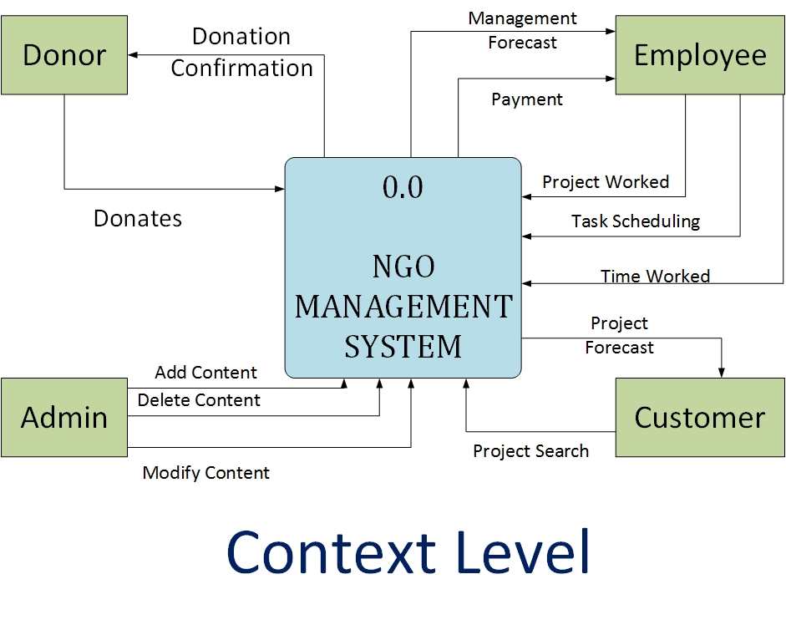
Context Level

Slide 10
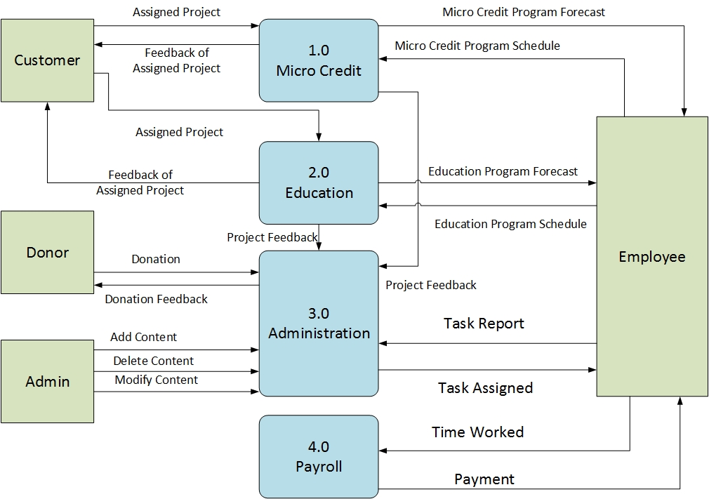
Level- 0

Slide 11
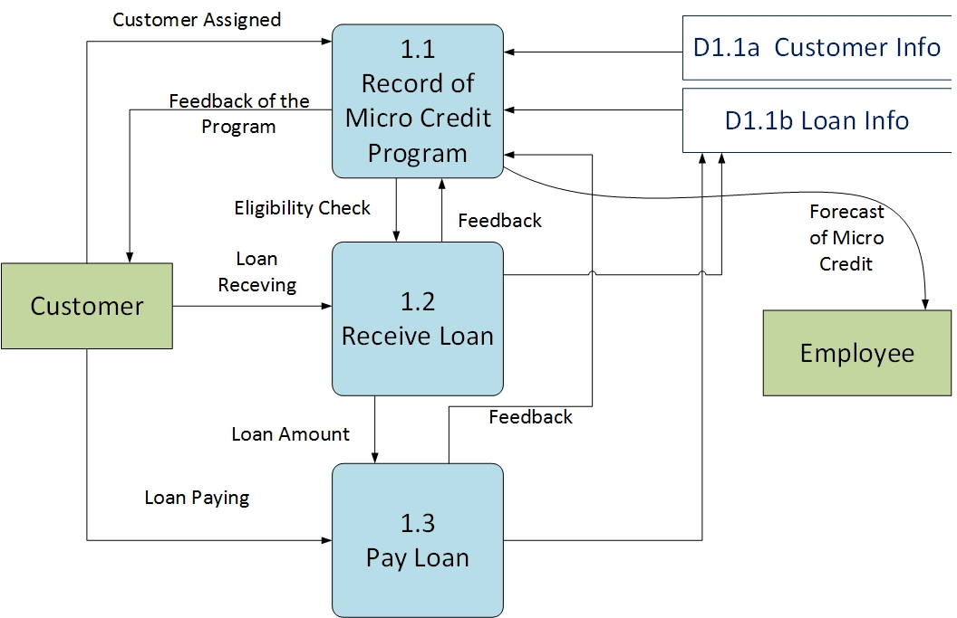
DFD Level 1

Slide 12
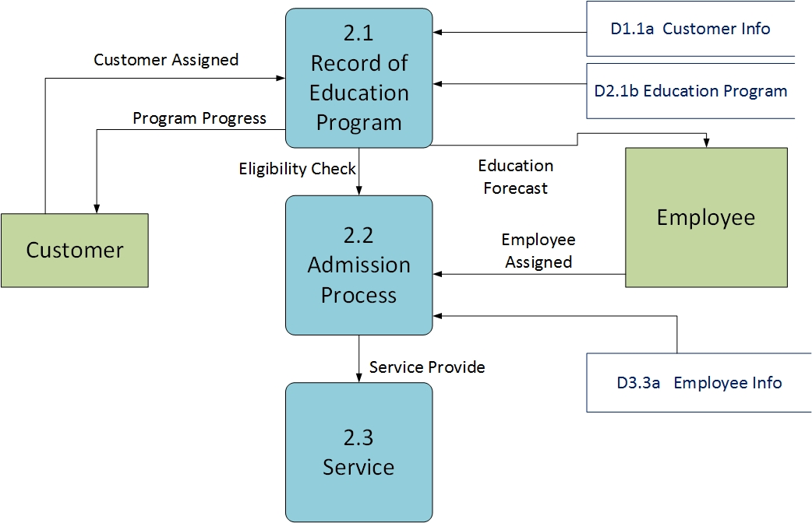
DFD Level 1

Slide 13
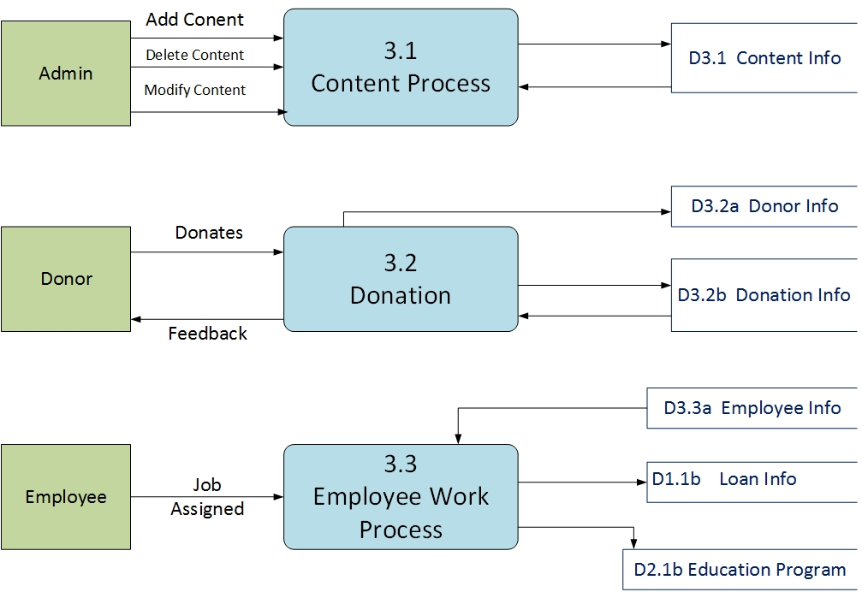
DFD Level 1

Slide 14
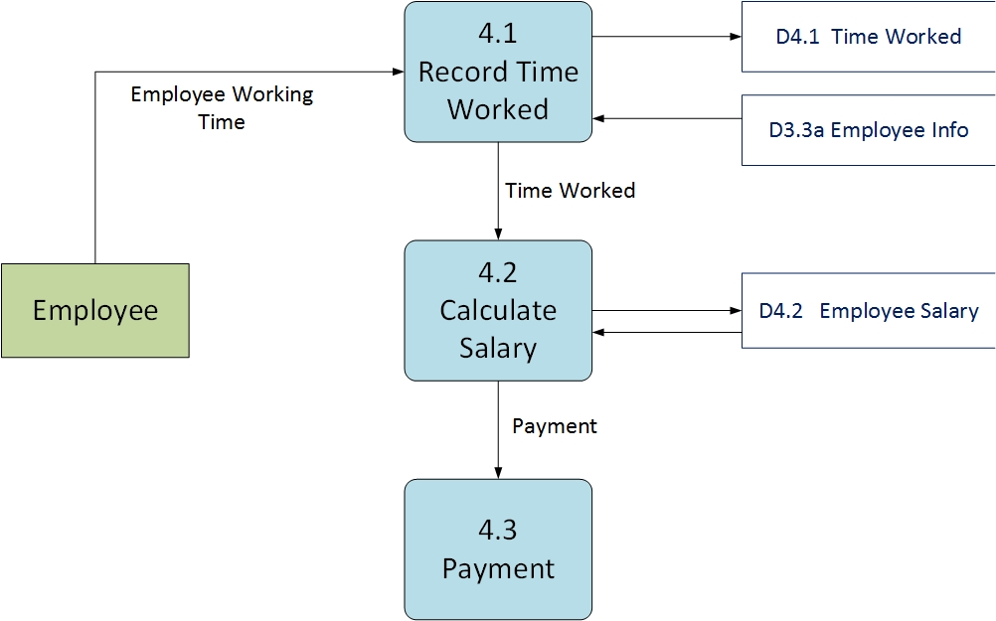
DFD Level 1

Slide 15
Use Case
Use Case Modelling

Slide 16
Use Case Actor
Visitor
Donor
Admin
Employee
Customer

Slide 17
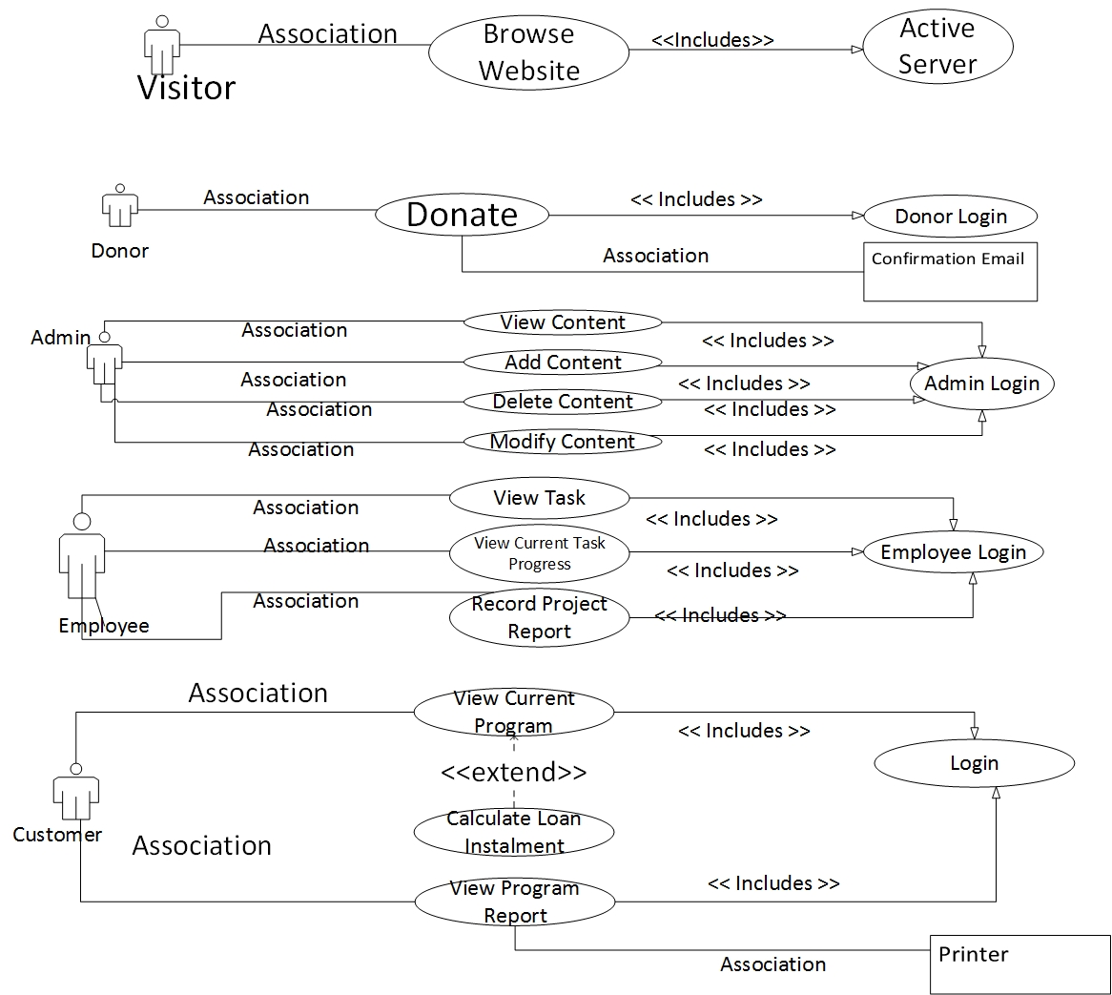
Use Case: NGO Management System

Slide 18
Use Case Modelling (Visitor)

Slide 19
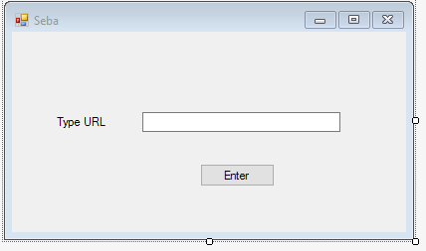
Use Case: Browse Website
Use Case: Browse Website
Actor: Visitor
Pre-Condition: Active Server
Primary Path: Type Web Address, Click Enter Button
Alternate Path: Wrong Web Address

Slide 20
Use Case Modelling (Donor)

Slide 21
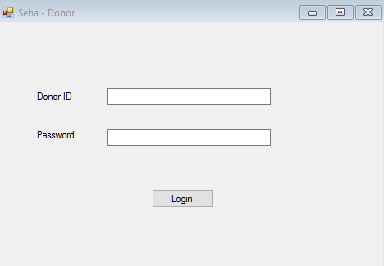
Use Case: Donor Login
Use Case: Donor Login
Actor: System
Pre-Condition: None
Primary Path: Insert Donor ID, Insert Password, Click Login
Alternate Path: Wrong Donor ID, Wrong Password

Slide 22
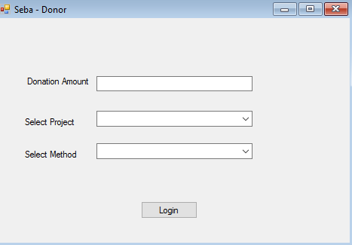
Use Case: Donate
Use Case: Donate
Actor: Donor
Pre-Condition: Donor Login
Primary Path: Writing the amount to be donated, Select Project, Select Method, Click “Donate” Button
Alternate Path: Wrong Amount, Wrong Project

Slide 23
Use Case Modelling (Admin)

Slide 24
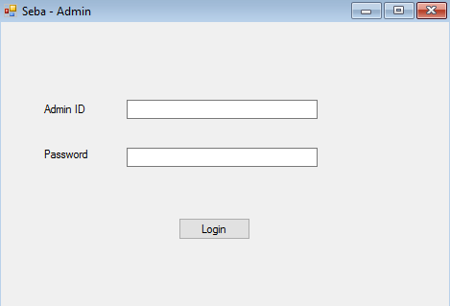
Use Case: Admin Login
Use Case : Admin login
Actor : System
Pre-Condition : None
Primary Path :
i) Enter Admin ID
ii)Enter Password
iii) Click “Login”
Alternate Path:
i) Wrong ID ii) Wrong Password

Slide 25
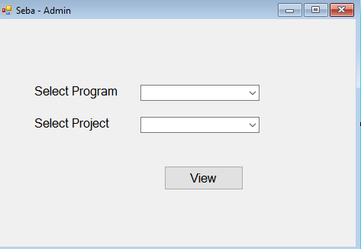
Use Case: Admin View Content
Use Case : View Content
Actor : Admin
Pre-Condition : Login
Primary Path :
i) Select Program
ii) Select Project
iii) Click “View”
Alternate Path:
i) Wrong Program ii) Project not Available

Slide 26
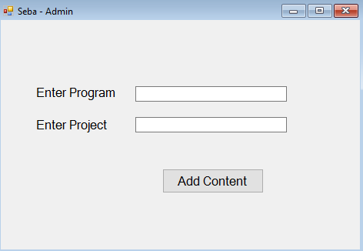
Use Case: Admin Add Content
Use Case: Add Content
Actor : Admin
Pre-Condition : Login
Primary Path :
i) Enter Program
ii) Enter Project
iii) Click “Add Content”
Alternate Path:
i) Program & Project already saved

Slide 27
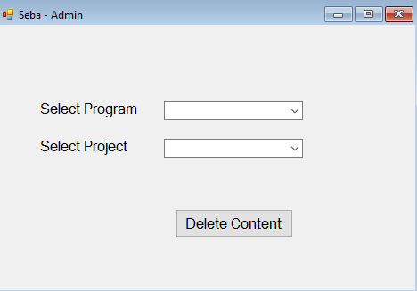
Use Case: Admin Delete Content
Use Case : Delete Content
Actor : Admin
Pre-Condition : Login
Primary Path :
i) Select Program
ii) Select Project
iii) Click “Delete Content”
Alternate Path:
i) Wrong Program
ii)Project Not Found

Slide 28
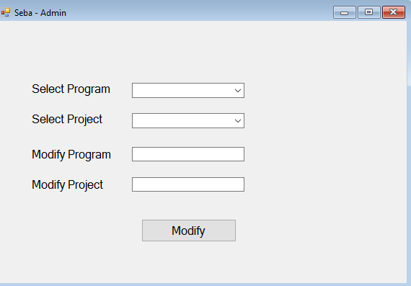
Use Case: Admin Modify Content
Use Case : Modify Content
Actor : Admin
Pre-Condition : Login
Primary Path :
i) Select Program
ii) Select Project
iii) Modify Program & Modify Project
iii) Click “Modify Content”
Alternate Path:
i) Wrong Program
ii)Project Not Found

Slide 29
Use Case Modelling(Employee)

Slide 30
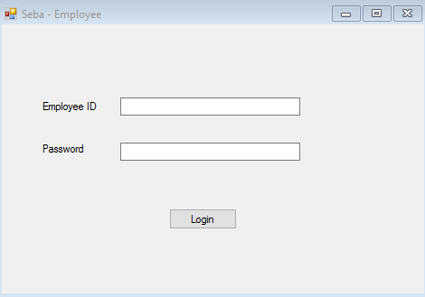
Use Case: Employee Login
Use Case : Employee Login
Actor : Employee
Pre-Condition : None
Primary Path :
i) Insert ID
ii) Insert Password
iii) Click “Login Button”
Alternate Path:
i) Wrong ID
ii)Wrong Password

Slide 31
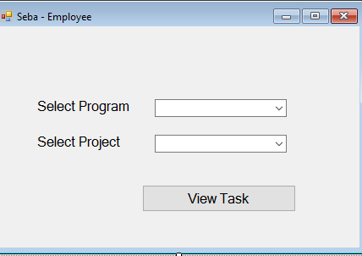
Use Case: Employee View Task
Use Case : Employee View Task
Actor : Employee
Pre-Condition : Login
Primary Path :
i) Select Project
ii) Select Program
iii) Select “View Task” Button
Alternate Path:
i) Wrong Program/Project

Slide 32
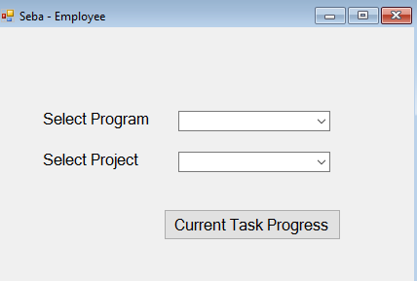
Use Case: Employee View Task Progress
Use Case : Employee View Current Task Progress
Actor : Employee
Pre-Condition : Login
Primary Path :
i) Select Program
ii) Select Project
iii) Select “Current Task Progress”
Alternate Path:
i) Wrong Program/Project

Slide 33
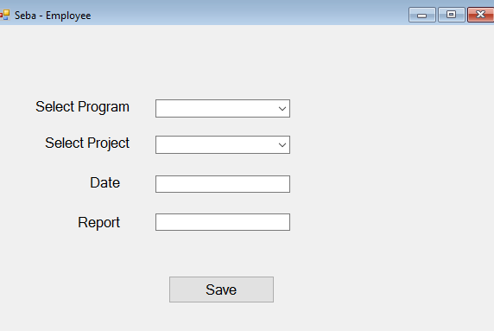
Use Case: Employee Record Project Report
Use Case : Employee Record Project Report
Actor : Employee
Pre-Condition : Login
Primary Path :
i) Select Program
ii) Select Project
iii) Type Date
iv) Type Project Report
v) Select “Save” Button
Alternate Path:
i) Wrong Program/Project

Slide 34
Use Case Modelling (Customer)

Slide 35
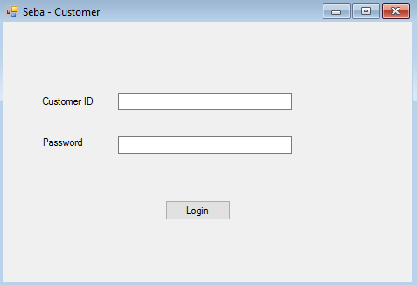
Use Case: Customer Login
Use Case : Customer Login
Actor : System
Pre-Condition : None
Primary Path :
i) Insert ID
ii) Insert Password
iii) Click “Login Button”
Alternate Path:
i) Wrong ID
ii)Wrong Password

Slide 36
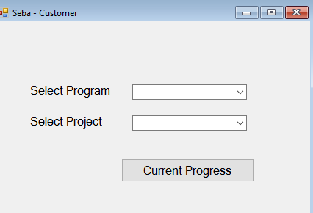
Use Case: Customer View Current Progress
Use Case : Customer View Current Progress
Actor : Customer
Pre-Condition : Login
Primary Path :
i) Select Program
ii) Select Project
iii) Select “Current Progress”
Alternate Path:
i) Wrong Program/Project

Slide 37
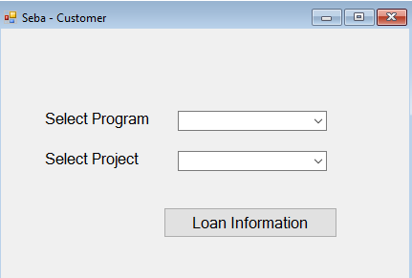
Use Case: Calculate Loan Instalment
Use Case : Calculate Loan Instalment
Actor : System
Pre-Condition : Login
Primary Path :
i) Select Program
ii) Select Project
iii) Select “Show Loan Information” Button
Alternate Path:
i) Wrong Program/Project

Slide 38
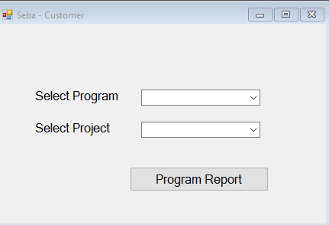
Use Case: Customer View Program Report
Use Case : Customer View Program Report
Actor : Customer
Pre-Condition : Login
Primary Path :
i) Select Program
ii) Select Project
iii) Select “View Program Report”
Alternate Path:
i) Wrong Program/Project

Slide 39
Question ??

